Slide 1
Evidence based Medicine
M.Khazaneha
Ph.D. in information science
2021

Slide 2
Heading
Introduction
Definition of Evidence Based Medicine •
Evidence-based health care practice •
Importance of EBM •
Evolution of EBM •
Decision making in EBM •
Five-Step Approach to Practicing EBM •
Benefits of adopting EBM •
Misconceptions in EBM •
Evidence-based Public Health •
Conclusion

Slide 3
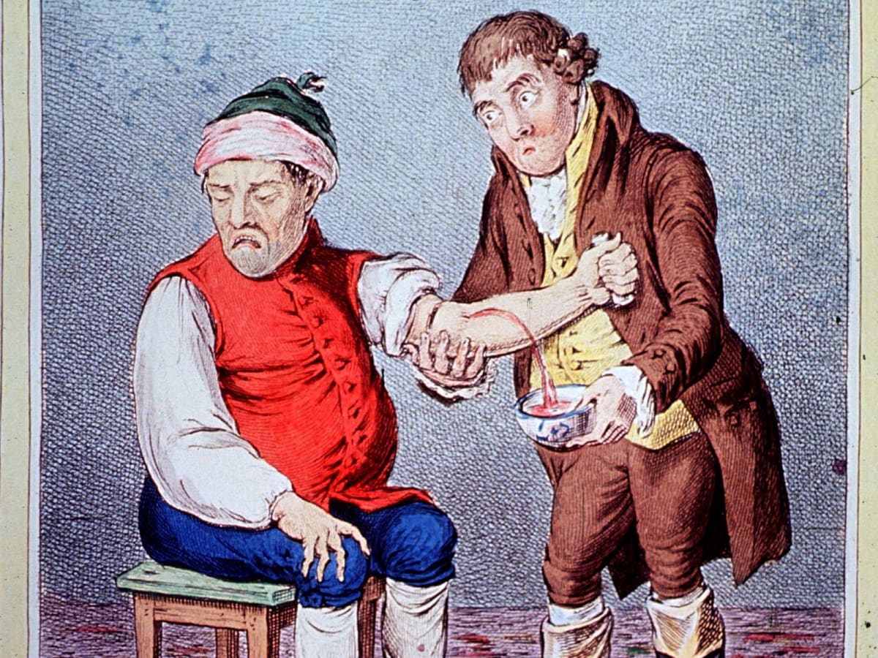
Bloodletting
Bloodletting
3000years ago Egyptians, Greeks then Romans, Arabs and so on. The cure for (hot, moist diseases) several medical conditions.
Galen was able to propagate his ideas through the force of personality and the power of the pen.

Slide 4
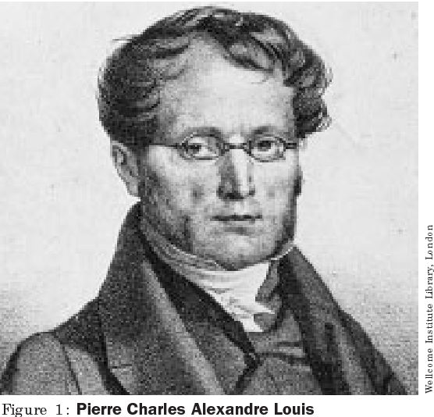
Pierre Louis (1787-1872)
Inventor of the “numeric method” and the “method of observation” French physician who wanted to analyze the efficacy of bloodletting in the treatment of acute pneumonia
Examined the clinical course and outcomes of 77 patients

Slide 5
Overall Results (n=77)
“Experimental” out Comparisons Group Absolute Risk Reduction Bled Early Phase Bled ,Late Phase, Difference
Mortality 44% 25% - 19%
Conclusion: Effect of bloodletting procedure was actually much less helpful than has been commonly believed

Slide 6
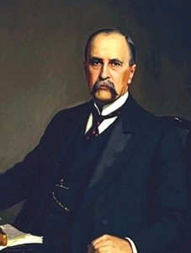
William Osler (1849 -1919)
First “attending physician” at Johns Hopkins Author of hugely influential textbook, 'The Principles and Practice of Medicine'
believed that most drugs in his day were useless, but still advocated blood-letting in some cases

Slide 7
Bloodletting today
phlebotomy therapy is primarily used in Western medicine for a few conditions such as
hemochromatosis, polycythemia vera, and porphyria cutanea tarda.
Why did it persist? It resulted from the dynamic interaction of social, economic, and intellectual pressures, a process that continues to determine medical practice

Slide 8
scenario
Patient:
Mr. A Mr. A is a 60 year old presenting with 1 hour of retrosternal chest pain.
ECG shows lateral ST-elevation consistent with acute MI.
QUESTION:
In patients with acute MI, does treatment with aspirin reduce mortality?
What is the best evidence?

Slide 9
Evidence: 1988
Reduction of mortality in acute myocardial infarction with streptokinase and aspirin therapy.
Results: – Patients with acute MI treated with Aspirin vs. placebo had a significant 23% relative risk reduction in five-week cardiovascular mortality, with an absolute risk reduction of 11.8% to 9.4% –
The combination of SK and Aspirin resulted in a 42% relative risk reduction in cardiovascular mortality after five weeks compared with the placebo

Slide 10
Application: 1997
How many patients receive ASA following acute myocardial infarction?
Aspirin was not given to 55%!!!
78% of patients who did receive aspirin received it more than 30 minutes after arrival to the emergency department.

Slide 11
But as late as 2000, even in the US, aspirin was being prescribed for at most one third of patients with coronary artery disease (for whom there were no contraindications to its use)
Relatively simple, and cheap practices shows that we have a problem in getting providers to apply knowledge gained through research
The paradigm for the translation of new information from research bench to bedside has been conceptualized as a “translational highway”.

Slide 12
What is Evidence-Based Medicine?
“Evidence-based medicine is the integration of best research evidence with clinical expertise and patient values”
David Sackett
“Explicit, judicious, and conscientious use of current best evidence from medical care research to make decisions about the medical care of individuals”

Slide 13
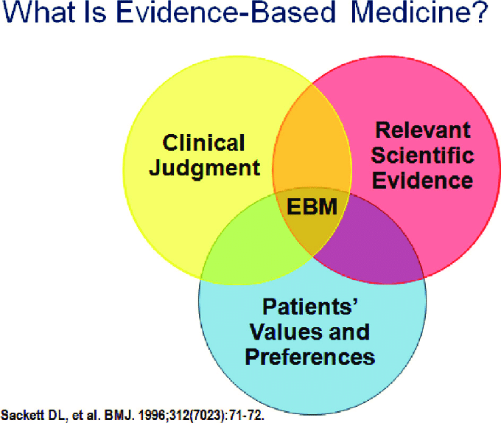

Slide 14
Evidence-based health-care practice
The integration of:
– individual clinical expertise
– best available external clinical evidence from systematic research

Slide 15
Why is EBM important?
New types of evidence are being generated which can create changes in the way patients are treated
Although evidence is needed on a daily basis, usually physicians don’t get it.
How much is actually being applied to patient care?
lack of time
out-of-date textbooks
the disorganization of the up-to-date journals

Slide 16
An EBM Approach to Education
1995
Looked up 2-3 questions per patient
Took 15-90 seconds to find
Change about 1/3 decision
David Sackett

Slide 17
Why the sudden interest in EBM?
Increasing realization among clinicians that years of experience unaccompanied by updating of knowledge can result in decline of clinical performance
The need for valid information about diagnosis, therapy, prognosis, and prevention in this era of consumer activism
The common man has access to the very same medical literature as the clinicians through numerous sources
Limited time available to the clinician for acquiring information is a major impediment for updating the knowledge from traditional sources

Slide 18
Assumptions of evidence-based practices
Not all evidence is equivalent
There is a hierarchy of study design
External evidence can inform but can never replace individual clinical expertise (Sackett et al., 1996)
Starting from the best external evidence and work from there.
Values always influence decisions

Slide 19
Where do we go for help with decisions when we are not sure how to proceed?????????

Slide 20
Decision making in clinical practice
using evidence Decision-making is the cognitive process resulting in the selection of a course of action among several alternative possibilities

Slide 21
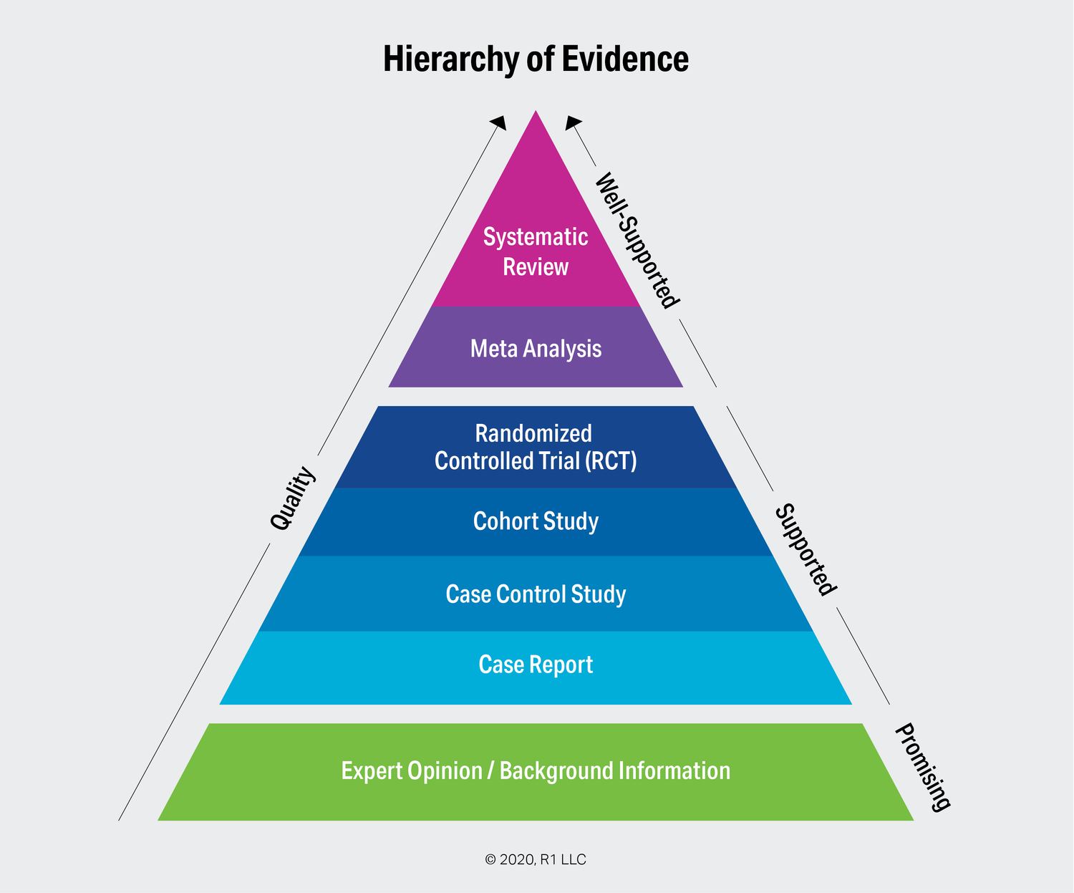
The evidence pyramid

Slide 22
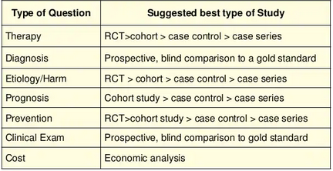
Identifying the best study

Slide 23
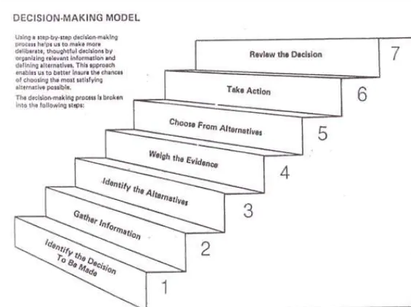

Slide 24
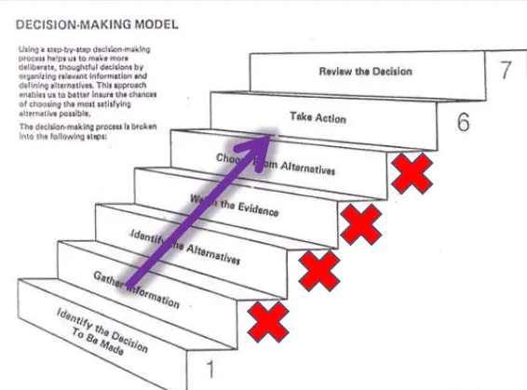

Slide 25
The Five-Step Approach to Practicing EBM
Step 1- Framing a Proper, Pertinent, Focused and Answerable Question
Step 2 - Searching the Literature
Step 3 - Critical Appraisal of the Literature
Step 4 –Integrating the Evidence with Clinical Expertise and Patient Values
Step 5 – Evaluating the Process

Slide 26
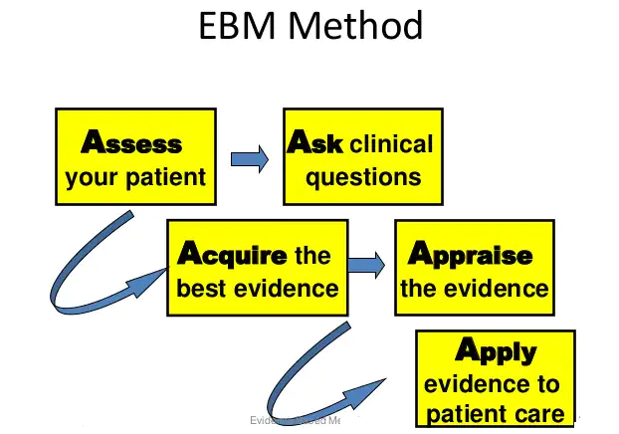
step1

Slide 27
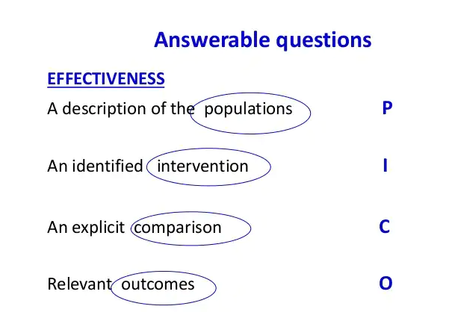

Slide 28
Step-2
Literature Search
‘Traditional’ print resources like textbooks or journals
‘Browse’ online electronic databases

Slide 29
Step 3 -
Critical Appraisal of the Literature
1. Screening for internal validity and relevance
2. Determining the intent of the article
3.Evaluating the validity based on its intent
The article that was tracked down is Prospective randomized placebo controlled clinical trial of Pralidoxime in two similar groups of patients. (Control group-low dose and study group-high dose) • Block randomization was used • The investigators were not blinded

Slide 30
Step 4 –
Integrating the Evidence with Clinical Expertise and Patient Values
The best documented critically appraised research evidence is already with the clinician
Take into consideration the patient values for example: The patient is a precious, lone male child of the parents. The economical/financial status of the parents does not permit expensive therapies No contraindications for the drug to be administrated Low dose regime requiring 1/16 of the high dose has better effect

Slide 31
Step 5 –
Evaluating the Process
Was he able to formulate a focused question?
Was he able to devise a precise search strategy for locating the evidence?
Did he use the most appropriate resource?
Were more pertinent resources like practice guidelines available to him?
Did the ‘evidence’ work in his patient?
The clinician should document the outcomes of the application of the evidence and based on his experiences
Those of his colleagues should be able develop management protocols

Slide 32
What are the benefits of adopting EBM?
Minimize the errors in patient care
Reduces the cost of treatment to the patient
Optimizes the quality of patient care
Skills learnt in practicing EBM are the very same ones needed for being a lifelong, self-directed learner
Habit of accessing literature on a daily basis is the best guarantor of ensuring advancement of knowledge and keeping abreast of scientific progress

Slide 33
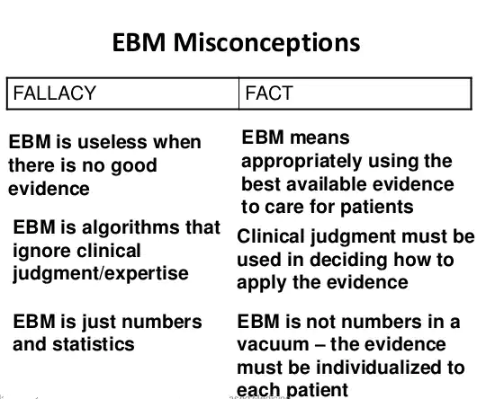

Slide 34
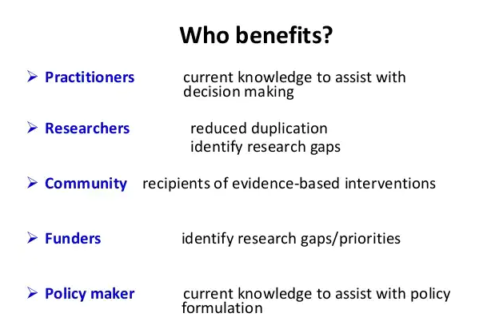

Slide 35
Conclusion
Medicine is not an exact science, but a science of probability
The challenge to physicians is to provide up to-date medical care
The ultimate goal for clinicians should be to help patients live long, functional, satisfying, and pain and symptom free life
By adopting the principles of Evidence Based Medicine, it will be possible to maximize the benefits of scientific research for patient care

Slide 36
Medical educators and medical colleges have the singular responsibility of indoctrinating the principles of EBM as a concept, a philosophy, a religion necessary for being efficient, compassionate, caring, and responsible clinician among the future physicians during their formative years of training

Slide 37
references
. Evidence-based Medicine Workbook-Finding and applying the better research , Paul Glasziou, Chris Del Mar and Janet Salisbury
2. Sackett, D. L., Straus, S. E., Richardson, W. S., Rosenberg,W., Haynes, R. B.: Evidence- Based Medicine – How to Practice and Teach EBM 2nd Ed., Churchill. Livingstone, 2000.
3. Sackett DL, Rosenberg WMC, Gray JA, Haynes RB Richardson WS. Evidence based medicine: What it is and what it isn’t Br. Med J 1996;312:71-72.
4. Evidence Based Medicine And Its Impact On Medical Education Dr. H. B. Rajashekhar1 Dr. B. S. Kodkany2 Dr. Vijaya A. Naik3 Dr. P. F. Kotur4 Dr. Shivaprasad S. Goudar5:Indian J. Anaesth. 2002; 46 (2) : 96-103
5. Guyatt GH, Evidence–based Medicine. Ann Intern Med. 1991;114(ACP J Club. Suppl 2): A-16

